Slide 1
Training Convnet with Backprop
Nilanjan Ray

Slide 2

Backpropagation (BP) for a conv layer
Input to convolution layer: I, a H-by-W matrix
Parameter of the layer: K, a h-by-w matrix
Output of the layer: J, a (H-h+1)-by-(W-w+1) matrix
Assume: H >= h and W >= w
I
*
J
$$J=I∗K$$
K
Given the gradient of loss function δJ with respect to J, BP tries to find answers to the following:
What is the gradient of the loss function with respect to K? Denote this gradient by δK.
What is the gradient of the loss function with respect to I? Denote this gradient by δI.
Why do we need δK? Because, we want to adjust the parameter K by gradient descent: K = K – (learning rate)δK
Why do we need δI? Because, we want to apply BP to the layer that precedes this conv layer.

Slide 3

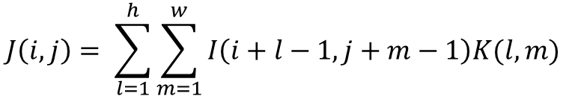

Derivation of δK
$$J\left(i,j\right)= \sum_{l=1}^{h}{\sum_{m=1}^{w}{I\left(i+l−1,j+m−1\right)K(l,m)}}$$
$$\frac{∂J(i,j)}{∂K(p,q)}=I(i+p−1,j+q−1)$$
Using chain rule of derivative:
$$δK\left(p,q\right)=\sum_{i=1}^{H−h+1}{\sum_{j=1}^{W−w+1}{\frac{∂J\left(i,j\right)}{∂K\left(p,q\right)}δJ(i,j)}}=\sum_{i=1}^{H−h+1}{\sum_{j=1}^{W−w+1}{I(i+p−1,j+q−1)δJ(i,j)}}$$
Thus,
$$δK=I∗δJ$$

Slide 4


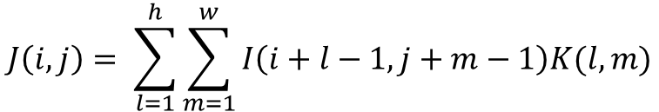

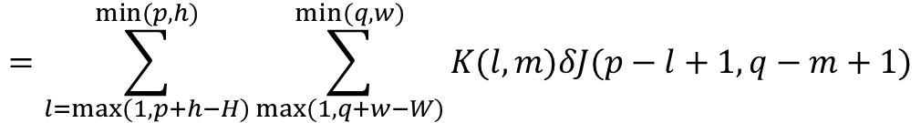
Derivation of δI
$$J\left(i,j\right)= \sum_{l=1}^{h}{\sum_{m=1}^{w}{I\left(i+l−1,j+m−1\right)K(l,m)}}$$
$$\frac{∂J(i,j)}{∂I(p,q)}=\left\{\begin{matrix}K\left(p−i+1,q−j+1\right), if 0≤p−i≤h−1 and 0≤q−j≤w−1, \\ 0, otherwise.\end{matrix}\right.$$
Using chain rule of derivative:
$$δI\left(p,q\right)=\sum_{i=1}^{H−h+1}{\sum_{j=1}^{W−w+1}{\frac{∂J\left(i,j\right)}{∂I\left(p,q\right)}δJ(i,j)}}=\sum_{i=max⁡(1,p−h+1)}^{min⁡(p,H−h+1)}{\sum_{j=max⁡(1,q−w+1)}^{min⁡(q,W−w+1)}{K(p−i+1,q−j+1)δJ(i,j)}}$$
$$=\sum_{l=max⁡(1,p+h−H)}^{min⁡(p,h)}{\sum_{max⁡(1,q+w−W)}^{min⁡(q,w)}{K(l,m)δJ(p−l+1,q−m+1)}}$$
Thus,
$$δI=pad\left(δJ\right)∗flip(K)$$
flip(K) is best understood by an example:
“pad” function adds (h-1) 0 rows at the top and bottom and
also adds (w-1) 0 columns at the left and at the right of a matrix.
Size of pad(δJ) is (H+h-1)-by-(W+w-1).
$$K=\left[\begin{matrix}1 & 3 & 5 \\ 2 & 4 & 6\end{matrix}\right]$$
$$flip\left(K\right)=\left[\begin{matrix}6 & 4 & 2 \\ 5 & 3 & 1\end{matrix}\right]$$

Slide 5




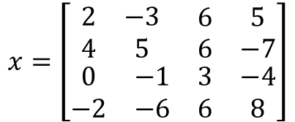
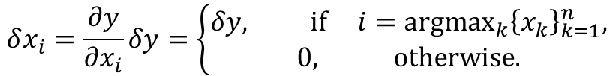

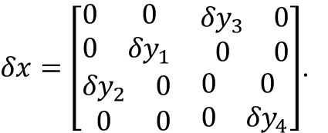
BP for a max pooling layer
$${\left\{x_{i}\right\}}_{i=1}^{n}$$
Max pool
$${y=max⁡(\left\{x_{i}\right\}}_{i=1}^{n})$$
Note that in case of a tie, only a single index
is chosen for the following operation:
$$i={argmax}_{k}{\left\{x_{k}\right\}}_{k=1}^{n}$$
By chain rule:
$$δx_{i}=\frac{∂y}{∂x_{i}}δy=\left\{\begin{matrix}δy, if i={argmax}_{k}{\left\{x_{k}\right\}}_{k=1}^{n}, \\ 0, otherwise.\end{matrix}\right.$$
Example of a 2-by-2, stride 2 max pooling:
Suppose,
$δy=\left[\begin{matrix}{δy}_{1} & {δy}_{3} \\ {δy}_{2} & {δy}_{4}\end{matrix}\right]$,
$$x=\left[\begin{matrix}\begin{matrix}2 & −3 \\ 4 & 5\end{matrix} & \begin{matrix}6 & 5 \\ 6 & −7\end{matrix} \\ \begin{matrix}0 & −1 \\ −2 & −6\end{matrix} & \begin{matrix}3 & −4 \\ 6 & 8\end{matrix}\end{matrix}\right]$$
Max pool
$$y=\left[\begin{matrix}5 & 6 \\ 0 & 8\end{matrix}\right]$$
$δx=\left[\begin{matrix}\begin{matrix}0 & 0 \\ 0 & {δy}_{1}\end{matrix} & \begin{matrix}{δy}_{3} & 0 \\ 0 & 0\end{matrix} \\ \begin{matrix}{δy}_{2} & 0 \\ 0 & 0\end{matrix} & \begin{matrix}0 & 0 \\ 0 & {δy}_{4}\end{matrix}\end{matrix}\right]$.
then,

Slide 6

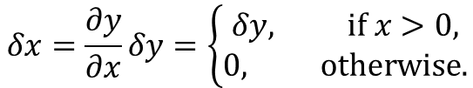



BP for a ReLU layer
x
ReLU
y = max(0, x)
By chain rule:
$$δx=\frac{∂y}{∂x}δy=\left\{\begin{matrix}δy, if x>0, \\ 0, otherwise.\end{matrix}\right.$$
$$x=\left[\begin{matrix}−5 & 4 \\ 0 & 2\end{matrix}\right]$$
ReLU
$$y=\left[\begin{matrix}0 & 4 \\ 0 & 2\end{matrix}\right]$$
Example:
Suppose,
$δy=\left[\begin{matrix}{δy}_{1} & {δy}_{3} \\ {δy}_{2} & {δy}_{4}\end{matrix}\right]$,
then
$δx=\left[\begin{matrix}0 & {δy}_{3} \\ 0 & {δy}_{4}\end{matrix}\right]$.

Slide 7
Putting it all together
Ideal output, q
Input
example
x
Conv
y
ReLU
z
Max pool
p
Loss
δy
δz
δp
K
Convnet training algorithm:
Initialize parameter K.
Iterate:
Step 1: (Forward pass)
Step 1a: Randomly choose a training example x and its corresponding ideal output q.
Step 1b: Pass x through “Conv” to get y; pass y though ReLU to get z; pass z through Max pool to get p.
Step 2: Compute “Loss” function for diagnostic purposes. /* Loss function measures deviation of p from q. */
Step 3: (Backward pass aka backpropagation)
Step 3a: Compute gradient of Loss function with respect to p. Denote this gradient by δp.
Step 3b: Compute δz given δp. /* Look at “BP for Max pooling.” */
Step 3c: Compute δy given δz. /* Look at “BP for ReLU.” */
Step 4c: Compute δK given δy. /* Look at “BP for Conv.” */
Step 4: (Update parameter K by gradient descent) K = K – (learning rate) δK.
An example network with 3 layers and a loss function
Note: We don’t have to compute δx, because there is no preceding layer before conv in the example above.

